Slide 1

Data Structures and Algorithms Final Project
Anuj Gupta (122561)

Slide 2
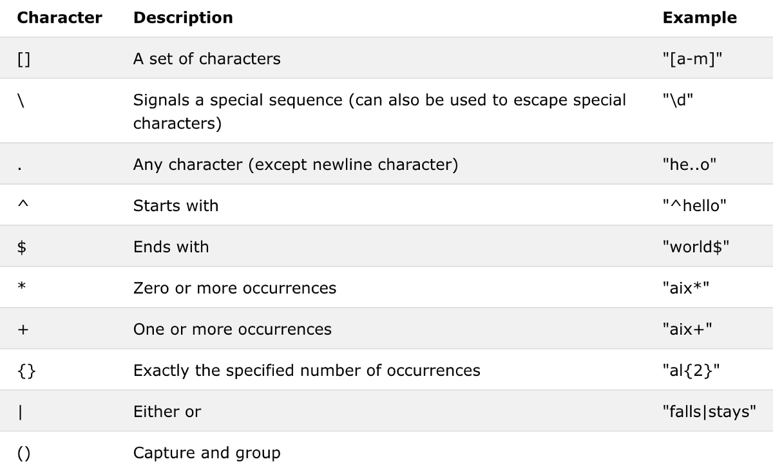
Brief Introduction to REGEX
Built in Python library that allows for pattern matching on strings of any size
Specific patterns used in this project:
. [dot] matches anything and everything (except \n)
| [vertical pipe] matches the patterns before and after it
* [asterisk] matches zero or more occurrences of the pattern before it
( ) [parentheses] groups patterns together
(?<=) [positive lookbehind] only extracts text following it
(?=) [positive lookahead] only extracts text preceding it
Special characters used in regex patterns (Wang, C.)

Slide 3


Brief Introduction to BEAUTIFUL SOUP
A specialized python library for extracting text from markup languages
Commonly used with a parser such as lxml for lighting fast lookup and data conversion
Other necessary libraries:
Python requests - numpy, pandas - Selenium (optional; for automating browser activity)
soup = BeautifulSoup(html_text, “html_parser”)
driver = webdriver.Chrome()
entries = soup.find_all(“tag”, “class_”)

Slide 4
limitations
With regular expressions, it is sometimes very difficult to parse html when multiple instances of the same pattern exists
When text between a certain tag does not exist (blank), regex will just ignore that entry instead of returning a blank string, causing issues with data consistency
When scraping multiple webpages using BS and Selenium, the speed of the scraping is completely bottlenecked by your internet speed and webpage loading
Some websites frown upon excessive scraping and even implement anti-scraping methods, always check for “robots.txt”
Code usually isn’t readily adaptable across websites

Slide 5
Future implementations
Add rating column to regex scraping algorithm like in the BS implementation
Add sorting algorithms to sort NBA by players, country, and team alphabetically
Split first name and last name of each player
Use the NBA website to group players into teams/positions/colleges/countries, and then perform scraping for each, for more powerful exploratory data analysis
Try other html parsers to compare speeds of each
Thank you! Any questions?

